Slide 1

New Aviation Fleet Acquisition Risk Analysis
Prepared for: Executive Leadership & Aviation Division
Prepared by : Mercy Apondi

Slide 2
BEGINNING
Overview
Business Understanding

Slide 3
OVERVIEW
The goal of this analysis is to help the company enter the aviation sector by identifying low-risk fleet using historical accident data from the National Transportation Safety Board (NTSB).
This is how this study has been achieved:
-Analyze 60 years of aircraft accident reports.
-Evaluate risk based on:
-Air Craft Category
-Engine Type and No. of Engines
- Make (Manufacturer)
-Injury Severity
-Aircraft Damage Outcomes
- Finally, Generate three insights tied to business recommendation.

Slide 4
BUSINESS UNDERSTANDING
Our Company wants to Invest in Aircraft for commercial and Private Operations. Before purchasing Aircraft, Leaders need to Understand:
Which Aircrafts Historically have the lowest accident and fatality rates.
Whether Engine type or number of Engines affect Safety.
Which Manufacturers have historically safer aircraft.
What type of accidents typically lead to severe injuries or total aircraft loss.
BUSINESS QUESTION
Which aircrafts generally in regards to type and specifications pose a low risk of operation for our proposed new aviation business?

Slide 5
MIDDLE
Data Understanding
Data Analysis

Slide 6
DATA UNDERSTANDING
The Source of Data is a Dataset by National Transportation Safety Board, Aviation Accident Data (1962_2023).
Description of Data
The data typically contains records of incidents, aircraft operation, make, airports operated in, flight details and safety outcomes (fatal, serious ,injured, uninjured). The contributing factors to injuries for different types of aircrafts.

Slide 7
DATA ANALYSIS
To Evaluate Aircraft Safety, we came up with the following conclusions to help determine which best Makes of Aircraft to purchase and their risk factors levels.
-Top 10 Makes with the Lowest Average Fatal Injuries per record.
- Worst 10 Makes by proportion of Accidents with Fatalities.
- Average Fatal Injuries by Aircraft Category

Slide 8
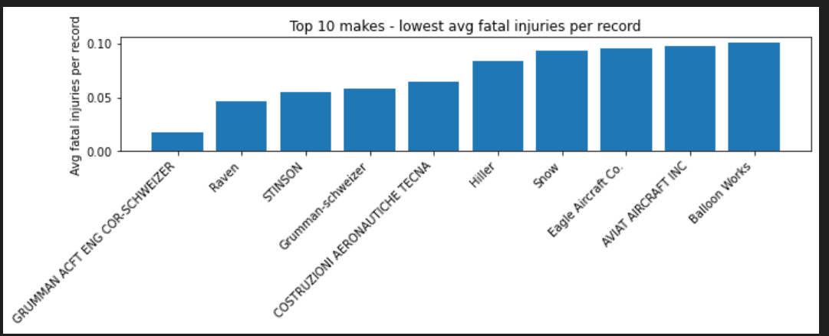
Plot A: Top 10 Makes with Lowest Average Fatal Per Record
This bar chart ranks aircraft manufacturers (make) by their average number of fatal injuries per incident, focusing only on makes with a sufficient number of records (e.g., ≥30) to ensure reliability.
Aircraft makes at the left (lowest bars) demonstrate consistently lower fatal outcomes across many historical incidents. This indicates:
Better aircraft design robustness
More reliable systems
Stronger safety track records in real-world operations
Data Visualization from Analysis

Slide 9
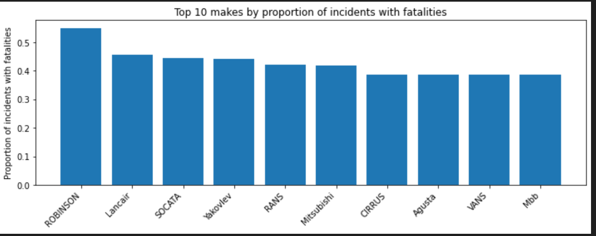
Plot B: Worst 10 Makes by proportion of Accidents with Fatalities
This chart highlights aircraft makes where a high percentage of incidents result in at least one fatality, regardless of how many total incidents they have.
Each bar = one aircraft manufacturer
Height of bar = likelihood that an incident involves a fatality
Focuses on risk probability, not severity size.
Some aircraft makes may not have many incidents, but when something goes wrong, it is more likely to be fatal. This indicates:
Less margin for error
Potential design, performance, or operational vulnerabilities
Higher insurance and liability exposure
Data Visualization from Analysis

Slide 10
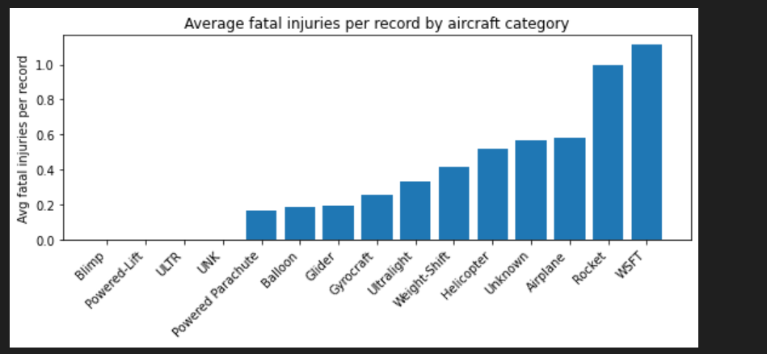
Plot C: Average Fatal Injuries by Aircraft Category
This graph compares broad aircraft categories (e.g., Transport, Commuter, Experimental, General Aviation) by average fatal injuries per incident. Certified commercial categories (such as Transport and Commuter aircraft) consistently show:
Lower average fatalities
Better survivability
More regulated design, maintenance, and pilot training standards
Non-certified or experimental categories show significantly higher fatal injury averages.
Data Visualization from Analysis

Slide 11
END
Recommendation
Next Steps
Thank you

Slide 12
Recommendation
Recommendations in order of Derived Graphs above respectively are as follows:
Prioritize purchasing aircraft from the top-ranked manufacturers in this chart, as they statistically produce fewer fatal injuries per incident and therefore reduce financial, legal, and reputational risk for the company.
Avoid or strictly limit investment in aircraft makes appearing in this chart, unless their use is restricted to non-commercial, low-exposure operations with enhanced training and safety controls.
Limit initial fleet purchases to certified commercial aircraft categories and avoid experimental or amateur-built categories for revenue-generating operations.
12

Slide 13
Next Steps
To minimize operational, financial, and reputational risk:
Build the initial aviation fleet using aircraft that:
Come from top-ranked manufacturers in Graph 1
Are absent from or low on the risk list in Graph 2
Belong to certified commercial aircraft categories shown as safest in Graph 3
13

Slide 14

Thank You!
Feel Free to ask any Questions and broader explanation on a slide to clarify further in Regards to the Analysis Provided. You can also use the below contacts to reach out to me!
LinkedIn – Mercy Apondi
Number - +254711659105
apondimercy11@gmail.com
14

Slide 15
Financial overview
Our financial overview reflects a robust and resilient fiscal performance.
Key indicators show consistent revenue growth over the past quarter, attributed to strategic cost management and successful marketing.
Operating margins have improved, signaling operational efficiency, while strengthening our reserves.
This underscores our commitment to financial stability, positioning us for sustained growth.
15

Slide 16
Quarterly targets
Quarter | Revenue growth (%) | Market share increase (%) | Customer acquisition
Q1 | 12 | 2 | 500
Q2 | 15 | 3 | 600
Q3 | 18 | 4 | 700
Q4 | 20 | 5 | 800
Market expansion
Product innovation
Customer retention
Operational efficiency

Slide 17
Financial snapshot
Metric | Current value | Previous quarter | Change (%)
Revenue | $2,500,000 | $2,200,000 | +14%
Operating expenses | $1,200,000 | $1,400,000 | -14%
Net profit | $1,000,000 | $800,000 | +25%
Operating margin | 40% | 36% | +4%
Cash reserves | $5,000,000 | $4,500,000 | +11%

Slide 18

Innovative solutions

Slide 19
Future initiatives
Product enhancement. Introduce regular updates and features to enhance product offerings.
Technology integration. Explore emerging technologies for potential integration into our operations.
Collaborative partnerships. Foster collaborations with tech innovators and industry leaders to drive innovation.
Green supply chain
Reduced carbon footprint
Waste reduction
Water conservation
19

Slide 20
Thank you
Mirjam Nilsson
mirjam@contoso.com
www.contoso.com

